Slide 1

Memory Skills Group
Week 1 : Introductions and an Overview of Cognitive Abilities
Rebecca Niebieszczanski (Trainee Clinical Psychologist)
Kirsty Ellis (Assistant Psychologist)
Lesley Stewart (Consultant Clinical Neuropsychologist)
Revised 2021
Grace Sunerton (Assistant Psychologist)
Alice Roblin (Senior Clinical Neuropsychologist)

Slide 2

Welcome!
Notes:
Welcome participants to the group
Explain that the group is for individuals who report difficulties with their memory
Important that we have realistic expectations that the group is not about ‘getting rid’ of our memory difficulties
The group will offer skills and information that will help us to manage these memory difficulties
2 hours with break

Slide 3




Housekeeping:
Notes:
Breaks – including toilet breaks
No recording of the session
Phones on silent/vibrate to minimise distractions

Slide 4

Session Outline
Group rules
Introductions
Hopes, fears and expectations
Aims and overview of the course
Pre-group measures
An overview of cognitive functioning and abilities
Goal setting
Out of session work
Summary

Slide 5

Group Rules
Confidentiality
Respect
Share thoughts, ideas and experiences
Time keeping
Mobile phones
Notes:
Confidentiality – please respect each others information. Please discuss your own thoughts and materials with others but protect the confidentiality of members of the group by keeping discussions to how you feel and your own situation. Limits
Respect each other and allow each other space to talk and share different opinions
Please talk slowly and thoughtfully speaking one at a time so that everyone can hear and follow what is being said
Time keeping – please arrive on time so that the group can start promptly
Please switch mobile phones to silent
Is there anything that you would suggest could help the group to run smoothly?

Slide 6
Introductions:
?
What’s your name? _____________________________
Tell me about yourself: ____________________________________ ____________________________________ ____________________________________
What’s your favourite thing to do? ____________________________________ ____________________________________
What’s the one thing you could not live without? ____________________________________
Page 5

Slide 7

Hopes, Fears, Expectations
What do you hope from this group?
What do you expect from the group?
Any fears about being in the group?

Slide 8
Course aims:
To develop knowledge and understanding of our memory and the process underpinning it
To develop awareness of and share our own difficulties
To develop internal and external strategies to support our memory
To increase knowledge and understanding of the impact of memory difficulties on our wellbeing
To develop an awareness of strategies to support psychological and emotional well-being
To increase our knowledge and understanding of cognitive functioning and abilities

Slide 9
Overview of the course:
Session 1 Introductions and an overview of cognitive abilities
Session 2 Overview of memory
Session 3 External memory enhancement strategies
Session 4 Internal memory enhancement strategies
Session 5 Mood and cognitive functioning
Session 6 Keeping well, course reviews and goodbyes
Notes:
6x 2 hour sessions
The emphasis of this group is active participation and it is equally important to contribute as much as you feel you can.
It is also important that you attend all the sessions, however, if for some reason you can’t attend the group - let us know
Taught materials
Discussions
Exercises and chances to practice
Contact details in booklet if need additional support, talk to facilitators
Facilitators might make notes throughout to remember content of session

Slide 10

Group measures
Notes:
Explain that participants will be asked to complete measures now and at the end of the course. This to monitor any general changes following the group, and to ensure that the group is meeting its’ aims.
Individual responses will not be identifiable. The front sheets will be used to match pre and post measures but will then be removed and shredded.

Slide 11
break

Slide 12

Cognitive Abilities
Memory
Language
Visuospatial Skills
Types of Cognitive Abilities
Attention
Information Processing
Executive Functioning
Notes:
The term cognitive ability is used to describe people’s thinking abilities; including problem solving, concentration and memory. Our minds are made up of lots of these abilities.
We will explore some of these in more detail below; however, for the purpose of this group we will not cover all cognitive abilities.
We all have our strengths as well as areas we find more difficult. Some of you may have completed a cognitive assessment before attending this group which helps us to identify these strengths and areas of difficulty.

Slide 13



Attention
Focused or selective attention
Sustained attention
Divided attention
Alternating Attention
I start doing something but then get distracted and start doing something else. Then I can’t remember what I was meant to be doing.
My mind often wanders when I read or watch TV. I’ll get to the end of a programme or page and have no idea what I read or watched.
Notes:
Attention is a complex thinking skill. Attention describes the process through which you select something to concentrate on, filter out distractions, maintain concentration and switch it when necessary.
Types of Attention
Focused or selective attention is your ability to choose something to pay attention to while filtering out and ignoring other stimuli like noise.
Sustained attention is your ability to keep concentrating on something over a period of time.
Divided attention is your ability to pay attention to more than one thing at the same time.
Alternating attention is your ability to switch your attention between two or more tasks.
How do you think people with attention difficulties can be affected?
Mind wanders
Find it hard to do more than one thing at once
Easily distracted

Slide 14

Information Processing
Taking in information
Processing information
Acting on information
It takes me longer to answer questions now. If someone asks me something I have to stop and think about what it means before I can answer.
If someone’s explaining what something means I have to ask them to slow down and repeat it because it takes a while for the information to sink in.
Notes:
Information processing refers to the process through which your mind takes in information, processes that information and acts on. We often talk about speed of information processing which refers to how quickly people are able to do this. For some people this may have slowed down which means that they find it hard to take new information in, especially when they’re trying to concentrate on lots of different things at once. Imagine that your mind works a bit like a computer.
If you have lots of programmes open at the same time this will put pressure on the computer and cause it to slow down. Equally, if you’re using one programme it might be overloaded with information. The same can happen with our minds, especially for people who have reduced speed of information processing. If you overload your mind, information might not go in properly.
Take longer to answer questions
Harder to do things ‘in the head’
Need more time for things to ‘sink in’

Slide 15
Executive Functioning
Planning and organising
Sequencing
Flexible thinking
Self-monitoring
Problem solving
Sometimes I find it hard to multi-task or change what I’m doing
I have trouble planning ahead what I need to do during the day or for specific tasks
Notes:
Executive functioning is a broad term used to describe our ability to regulate and organise our thoughts and activities and effectively make decisions.
Difficulty planning
Difficulty organising
Making decisions
Switching between tasks

Slide 16

Language
Expressive language
Receptive language
Articulation
I often find it hard to find the right words
I have trouble understanding conversations

Slide 17
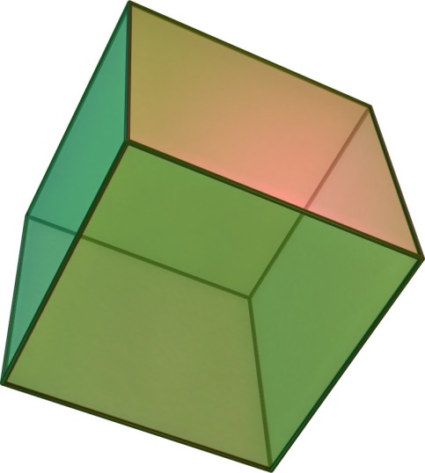
Visuo-Spatial Skills
Represent
Analyse
Manipulate
I often bump into things and find it hard to judge how where things are
I find it hard to figure out how to repair or build things
Notes:
What are visuospatial skills?
Visuospatial skill is the ability to represent, analyze, and mentally manipulate objects. There are two important concepts relating to visuospatial skills:
Spatial relations: the ability to represent and mentally manipulate two-dimensional objects.
Spatial visualization: the ability to represent and mentally manipulate three-dimensional objects.
Why are visuospatial skills important?
Visuospatial skills are very useful in everyday life. Thanks to them, we can estimate the distance between two objects, which can be helpful, for instance, when parking a car to monitor the space between the car and the surrounding obstacles. We also use visuospatial skills when imagining a place or address that someone mentions, or when we mentally rotate objects in order to visualize what they would look like before actually doing it.

Slide 18

Memory
Notes:
Used to describe the process through which people acquire information through their senses, store and recall that information.
Different types of memory
Will continue into session 2

Slide 19
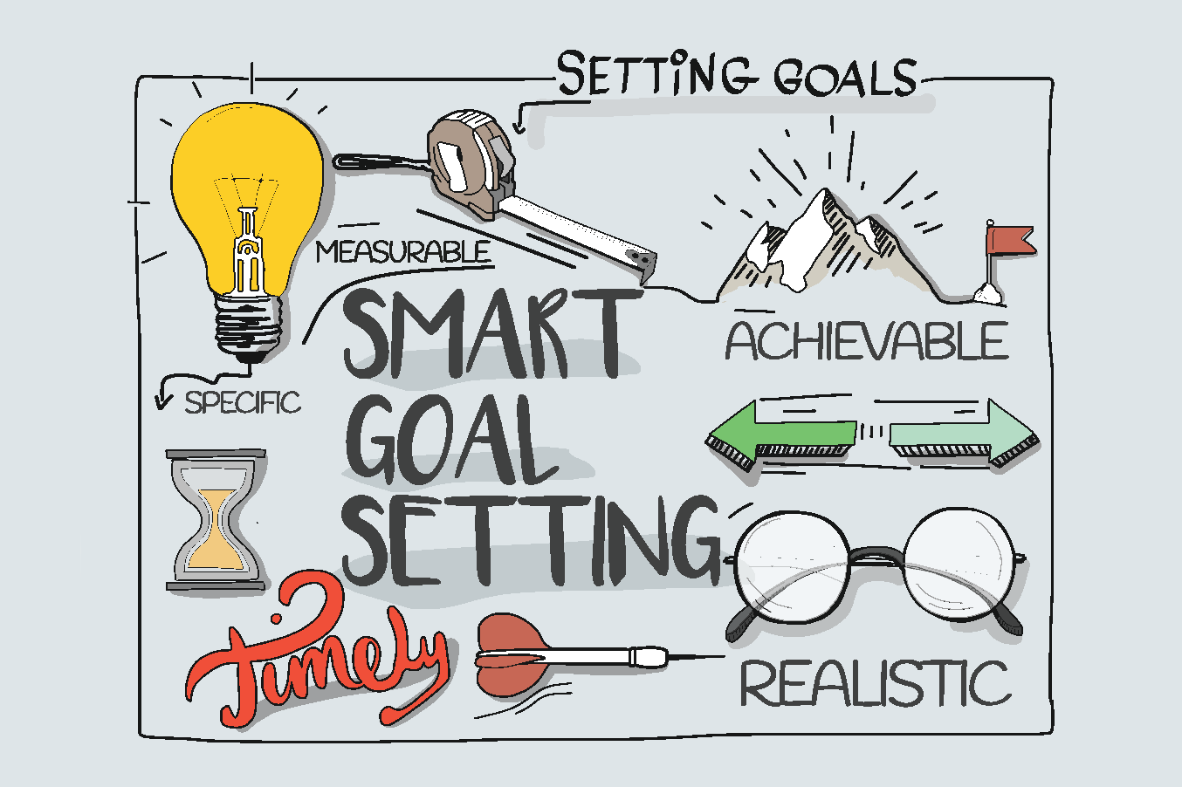
Goal Setting
Brainstorm
Re-examine
SMART
Action Plan
Obstacles
Reward
Notes:
Setting a major goal can be very stressful or even overwhelming. This is the type of goal that you will always start ‘tomorrow’ or ‘next week’, but those times never seem to come.
Learning to break your goals into small tasks will help you overcome the stress and procrastination they create. Think about taking a ‘stepped approach’, 1 step at a time!
Brainstorm: decide what you want to do. Identify goals for home, personal development etc.
Re-examine: once you;ve generated this list, go back and look at it closely identifying which goals are realistic and which might be unobtainable.
Rewrite the goals in terms of an outcome: make your goal a SMART goal!
Write out an action plan: break your goal into small steps that are needed to achieve it.
Identify obstacles: these are the things that will get in the way of achieving your goals.
Build in rewards and visualise the end result: have a clear mental picture of what you want to achieve to increase motivation.

Slide 20
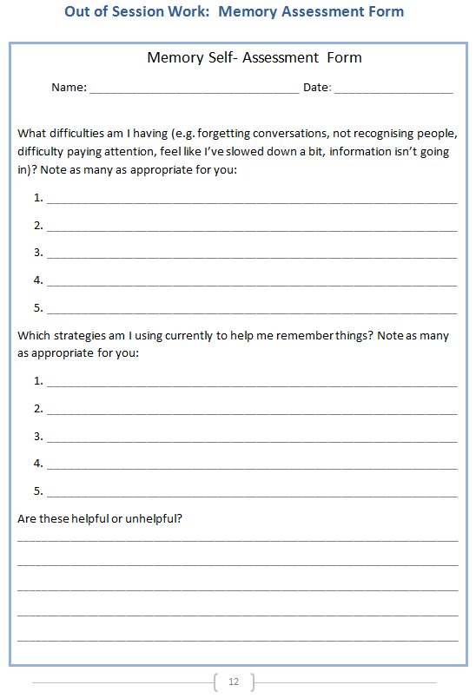
Out of Session Work
Weekly
SMART goals
Review in following session
‘Memory Self-Assessment’
Notes:
Helpful to think about own difficulties and to identify any strategies that are already providing to be useful, share them with the group

Slide 21

Next session
Breathing exercise
Grounding
Mindfulness
Notes:
At the start of the next session we will be doing a brief breathing exercise. This is because often when we attend the sessions there may be lots of things on our minds. Perhaps thoughts about what we’ve been doing, what we need to do, maybe some expectations or perhaps worries about what the group itself will be like. Our minds often wander and life is sometimes filled with stresses or worries. So we will do this breathing exercise to help us to feel more ‘grounded’ in the next session.

Slide 22

Summary
Introductions
Hopes, fear, expectations
Overview and aims of the course
Cognitive abilities (attention, information processing, executive functioning, language and visuo-spatial skills)
Goal setting
Home practice

Slide 23
Thank you for attending
Grace Sunerton, Assistant Psychologist
Jessica Haselhurst, Trainee Clinical Psychologist
01782 275188
Notes:
Contact details if you are having difficulties with the programme. There will also be space to ask any questions and explore with us your difficulties within the group if you feel comfortable sharing these.

